Slide 1
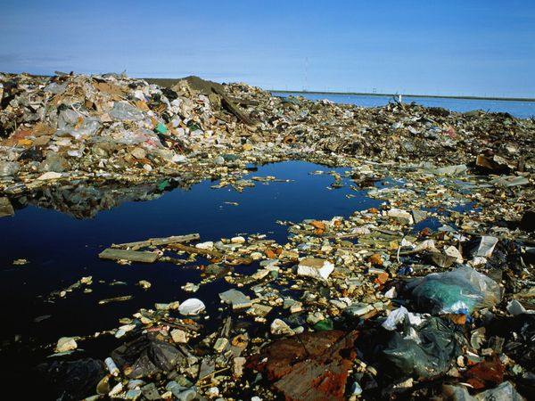
Marine Pollution

Slide 2
Marine Pollution
The Discharge of waste substances into the sea resulting in harm to living things, hazards to human health, hindrance to fishery and impairment of quality for use of water.

Slide 3
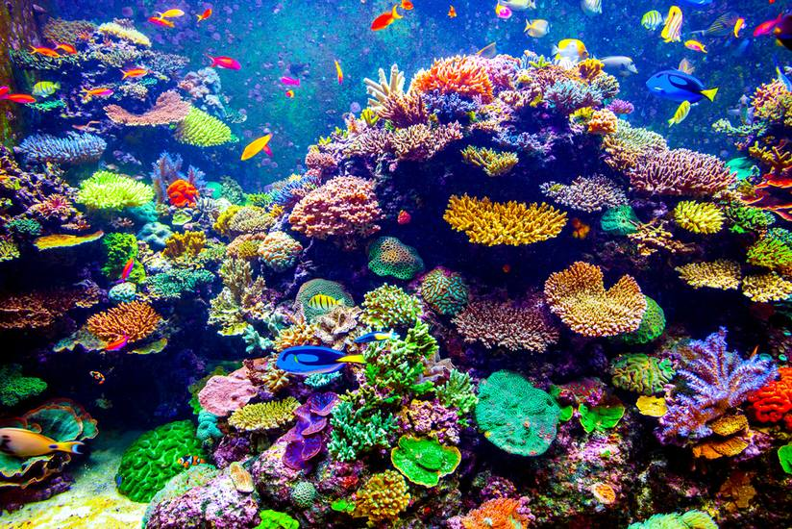
Coral Reefs

Slide 4
Coral Reefs
It is underwater structures made by calcium carbonate secreted by corals.
Benefits
It supports more than millions of species.
Provides feeding and breeding areas for fish and shell fishes.
Gives the medicines.
Act as buffer to ocean wave and protects the costal lines.

Slide 5
Factors Affecting Coral Reefs
Sediments from deforestation carried by the runoffs.
Agricultural and Industrial Chemical reached through river discharge.
Boat anchors and divers.
Rising Ocean Temperature and Acidification.

Slide 6
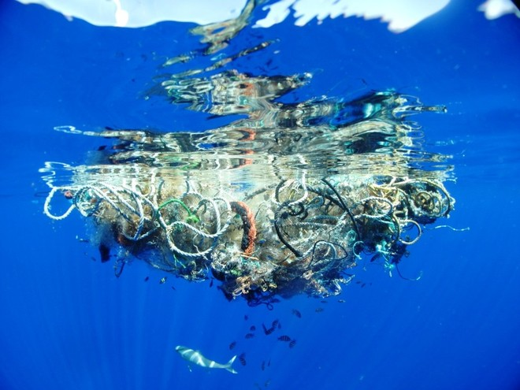
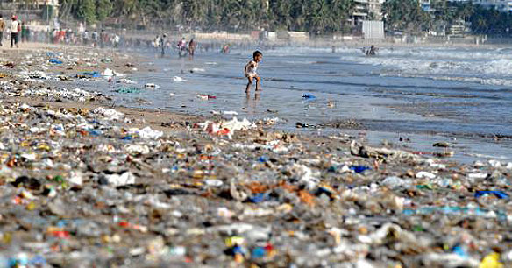
Sources of Marine Pollution
Dumping of wastes.
Untreated Sewages.
Huge Quantity of plastics.

Slide 7
Sources of Marine Pollution
Oil Pollution
By Petroleum Products.
Heavy Petroleum Products are easily absorbed by rocks and sand banks.
Effects
It affects the photosynthesis of plants.
It breaks the food chain of aquatic ecosystem.

Slide 8
Effects of Marine Pollution
Organic pollutants and heavy metals affects the egg shells and tissues of the birds.
Oil pollution it kills 50,000 to 2,50,000 marine lives every day.
Oil films reduces the DO level.
Hydrocarbons are accumulated in food chain it causes cancer to the human via sea foods.

Slide 9
Control Measures of Marine Pollution
Plans for conserving marine diversity.
People should be educated with marine ecosystem.
Local communities must involved in protecting and managing their coastal resources.
Social and economic incentive must be offered for conserving and sustainable use of marine resources.
Government must manage their own waters.

Slide 10
Methods of removal of oil
Physical
Skimming oil surface with suction device.
Absorb using forms.
Chemical Methods
Dispersion.
Emulsification.
Using chemical additives.

